Slide 1

TCP Basics
  Mayank Pandey
  Motilal Nehru National Institute of Technology,
  Allahabad, Uttar Pradesh, India

Slide 2
Transport Protocols
Protocol implemented entirely at the ends
  Fate-sharing
  Completeness/correctness of function implementations
UDP provides just integrity and demux
TCP adds…
  Connection-oriented
  Reliable
  Ordered
  Point-to-point
  Byte-stream
  Full duplex
  Flow and congestion controlled

Slide 3
UDP: User Datagram Protocol [RFC 768]
Minimal Transport Service:
“Best effort” service, UDP segments may be:
  Lost
  Delivered out of order to app
Connectionless:
  No handshaking between UDP sender, receiver
  Each UDP segment handled independently of others
Why is there a UDP?
No connection establishment (which can add delay)
Simple: no connection state at sender, receiver
Small header
No congestion control: UDP can blast away as fast as desired: dubious!

Slide 4
Introduction to TCP
Communication abstraction:
  Reliable
  Ordered
  Point-to-point
  Byte-stream
  Full duplex
  Flow and congestion controlled
Protocol implemented entirely at the ends

Slide 5
Evolution of TCP
1975
Three-way handshake
Raymond Tomlinson
In SIGCOMM 75
1984
Nagel’s algorithm
to reduce overhead
of small packets;
predicts congestion collapse
1987
Karn’s algorithm
to better estimate round-trip time
1990
4.3BSD Reno
fast retransmit
delayed ACK’s
1983
BSD Unix 4.2
supports TCP/IP
1986
Congestion collapse
observed
1988
Van Jacobson’s algorithms
congestion avoidance and congestion control
(most implemented in 4.3BSD Tahoe)
1974
TCP described by
Vint Cerf and Bob Kahn
In IEEE Trans Comm
1982
TCP & IP
RFC 793 & 791
1975
1980
1985
1990

Slide 6
TCP Through the 1990s
1994
T/TCP
(Braden)
Transaction
TCP
1996
SACK TCP
(Floyd et al)
Selective Acknowledgement
1993
TCP Vegas
(Brakmo et al)
real congestion avoidance
1994
ECN
(Floyd)
Explicit
Congestion
Notification
1996
Hoe
Improving TCP startup
1996
FACK TCP
(Mathis et al)
extension to SACK
1993
1994
1996

Slide 7
TCP Header
Source port
Destination port
Sequence number
Flags:
SYN
FIN
RESET
PUSH
URG
ACK
Acknowledgement
HdrLen
0
Flags
Advertised window
Checksum
Urgent pointer
Options (variable)
Data

Slide 8
TCP Usage Model
Connection setup
○3-way handshake
Data transport
○Sender writes data
○TCP
Breaks data into segments
Sends each segment over IP
Retransmits, reorders and removes duplicates
Receiver reads some data
Teardown
○4 step exchange

Slide 9
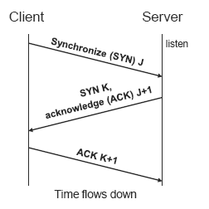
TCP Connection Establishment
3-Way Handshake
--Sequence Numbers
--J,K
Message Types
Synchronize (SYN)
Acknowledge (ACK)
Passive Open
--Server listens
Active Open
--Client initiates connection

Slide 10
TCP Data Transport
Data broken into segments
○Limited by maximum segment size (MSS)
○Defaults to 352 bytes
○Negotiable during connection setup
○Typically set to
----MTU of directly connected network –size of TCP and IP headers

Slide 11
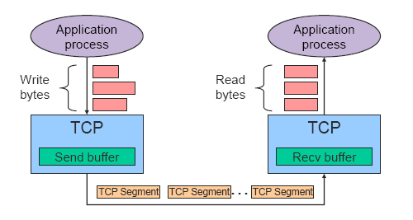
TCP Byte Stream

Slide 12
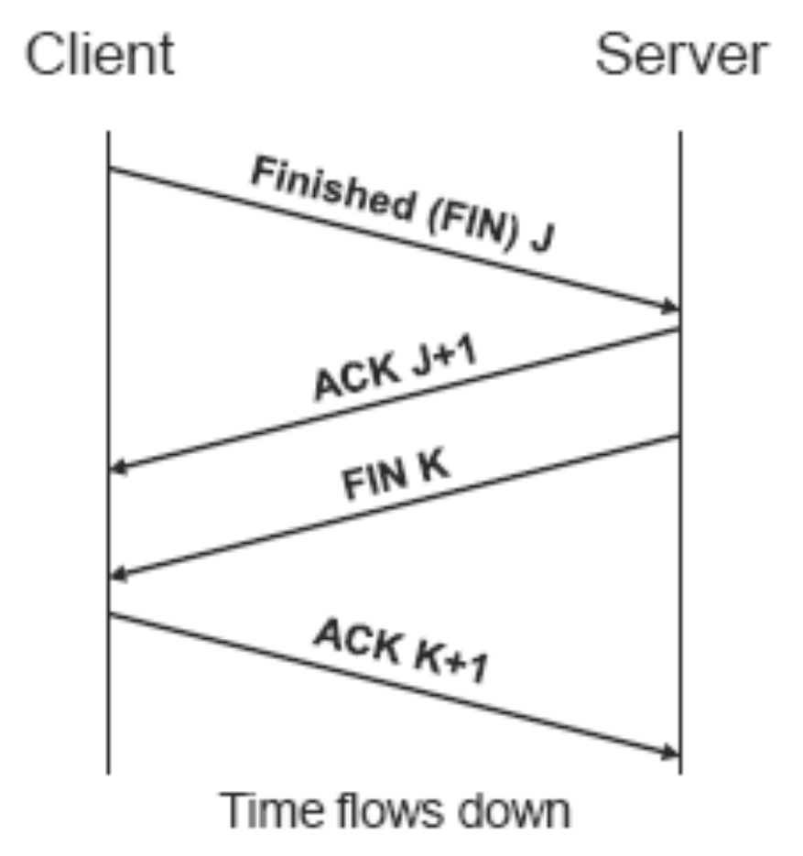
TCP Connection Termination
Message Types
○Finished (FIN)
○Acknowledge (ACK)
Active Close
○Sends no more data
Passive close
○Accepts no more data

Slide 13
Flow/Congestion/Error Control
Flow Control: Algorithms to prevent that the sender overruns the receiver with information
Error Control: Algorithms to recover or conceal the effects from packet losses
Congestion Control: Algorithms to prevent that the sender overloads the network
→ The goal of each of the control mechanisms are different.
→ In TCP, the implementation of these algorithms is combined

Slide 14

Acknowledgements in TCP
TCP receivers use acknowledgments (ACKs) to confirm the receipt of data to the sender
Acknowledgment can be added (“piggybacked”) to a data segment that carries data in the opposite direction
ACK information is included in TCP header
Acknowledgements are used for flow control, error control, and congestion control
Data for B
A
Data for A
ACK
B
ACK

Slide 15
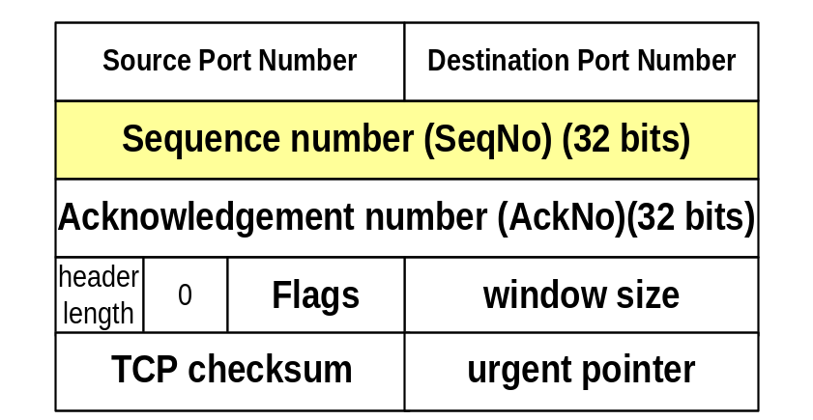
Sequence Numbers
TCP uses sequence numbers to keep track of transmitted and acknowledged data
Each transmitted byte of payload data is associated with a sequence number
Sequence numbers count bytes and not segments
Sequence number of first byte in payload is written in SeqNo field
Sequence numbers wrap when they reach 2³²-1
(Initial sequence number) is negotiated during connection setup

Slide 16
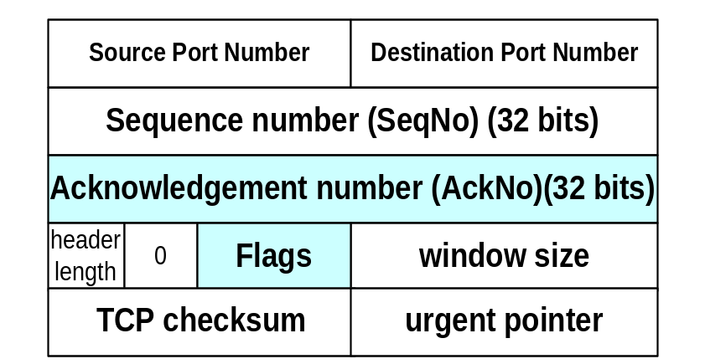
Sequence Numbers
Acknowledgment: confirmation of delivery
TCP receiver wants to acknowledge data, it
  writes a sequence number in the AckNo field
  sets the ACK flag
IMPORTANT: An acknowledgment confirms receipt for all unacknowledged data that has a smaller sequence number than given in the AckNo field
Example: AckNo=5 confirms delivery for 1,2,3,4 (but not 5).

Slide 17
Cumulative Acknowledgements
TCP has cumulative acknowledgements:
An acknowledgment confirms the receipt of all unacknowledged data with a smaller sequence number
SeqNo=20
10 bytes
SeqNo=10
10 bytes
SeqNo=90
10 bytes
SeqNo=0
10 bytes
SeqNo=30
10 bytes
SeqNo=40
10 bytes
SeqNo=50
10 bytes
SeqNo=60
10 bytes
SeqNo=70
10 bytes
SeqNo=80
10 bytes
A
B
ACK 10
ACK 20
ACK 40
ACK 70
ACK 100

Slide 18
Cumulative Acknowledgements
With cumulative ACKs, the receiver can only acknowledge a segment if all previous segments have been received
With cumulative ACKs, receiver cannot selectively acknowledge blocks of segments:
e.g., ACK for S₀-S₃ and S₅-S₇ (but not for S₄)
Note: The use of cumulative ACKs imposes constraints on the retransmission schemes:
  In case of an error, the sender may need to retransmit all data that has not been acknowledged

Slide 19
TCP Flow Control

Slide 20
TCP Flow Control
TCP uses a version of the sliding window flow control, where
  Sending acknowledgements is separated from setting the window size at sender
  Acknowledgements do not automatically increase the window size
During connection establishment, both ends of a TCP connection set the initial size of the sliding window

Slide 21
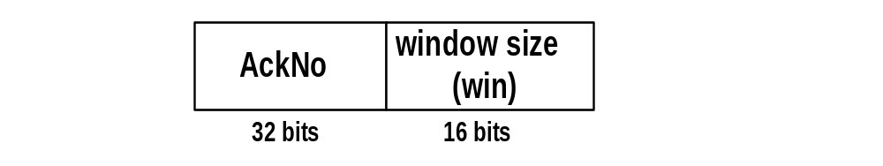
Window Management in TCP
The receiver is returning two parameters to the sender
The interpretation is:
    I am ready to receive new data with
    SeqNo= AckNo, AckNo+1, …., AckNo+Win-1

Slide 22
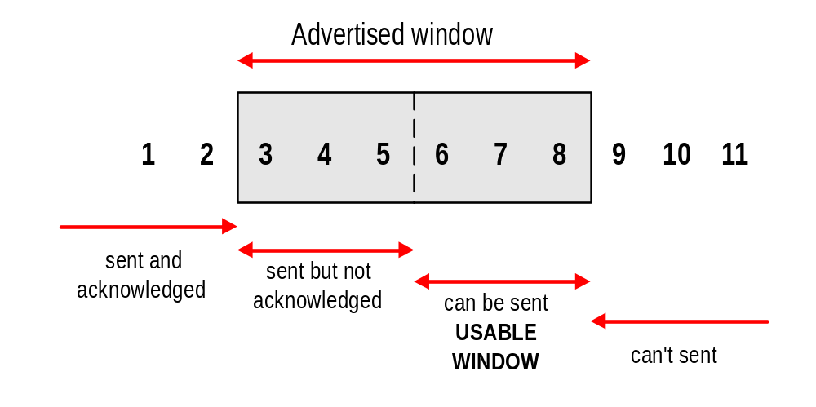
Sliding Window Flow Control
Sliding Window Protocol is performed at the byte level:
Here: Sender can transmit sequence numbers 6,7,8.

Slide 23
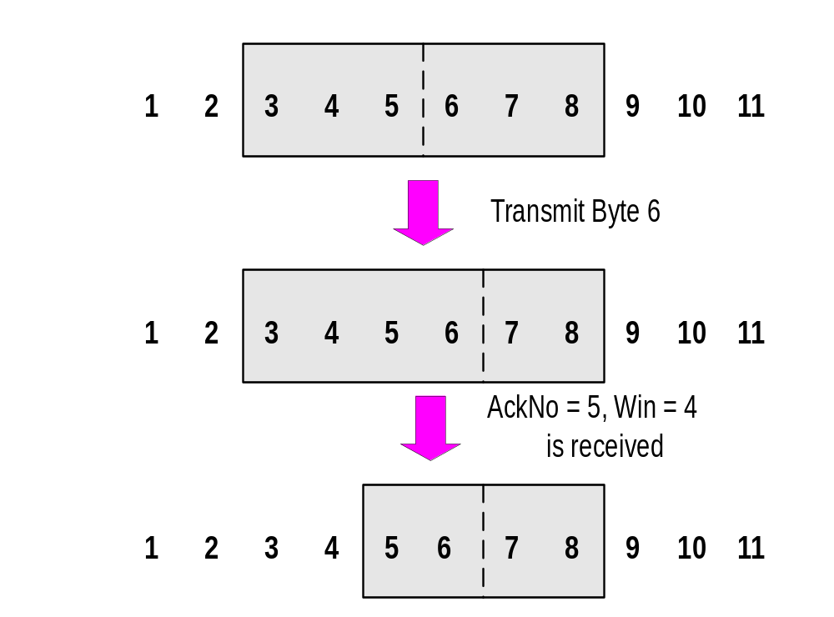
Sliding Window: “Window Closes”
Transmission of a single byte (with SeqNo = 6) and acknowledgement is received (AckNo = 5, Win=4):

Slide 24
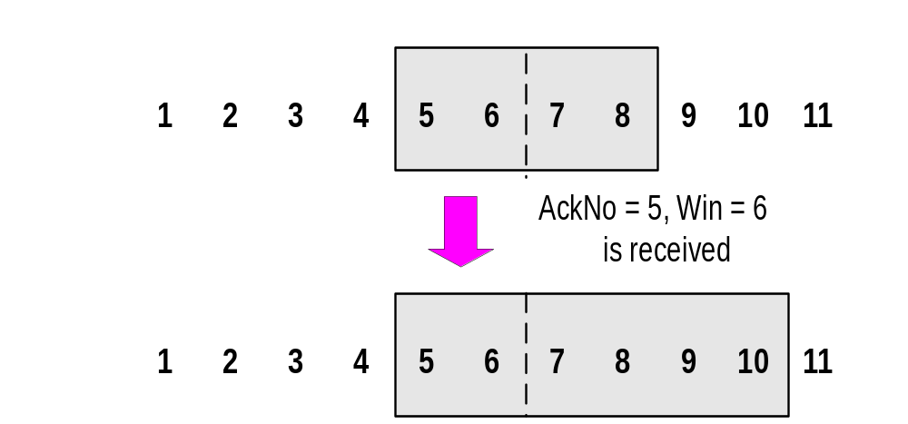
Sliding Window: “Window Opens”
Acknowledgement is received that enlarges the window to the right (AckNo = 5, Win=6):
A receiver opens a window when TCP buffer empties (meaning that data is delivered to the application).

Slide 25
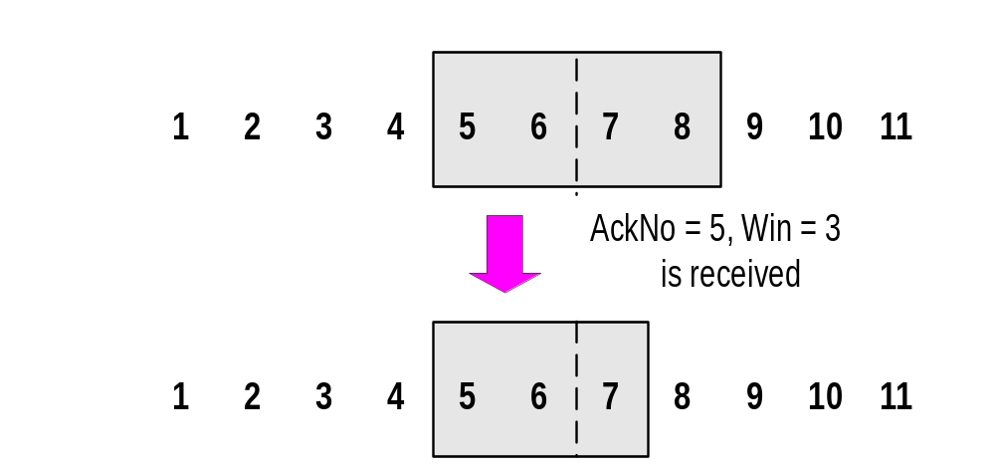
Sliding Window: “Window Shrinks”
Acknowledgement is received that reduces the window from the right (AckNo = 5, Win=3):
Shrinking a window should not be used

Slide 26
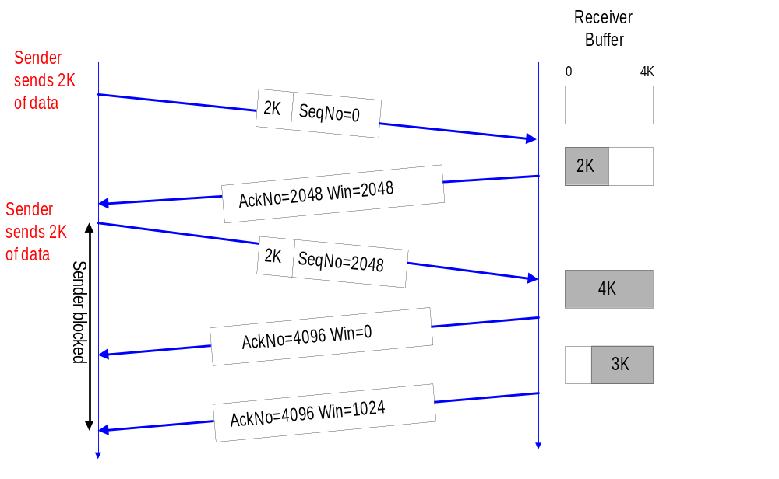
Sliding Window: Example

Slide 27
Error Control in TCP
TCP maintains a Retransmission Timer for each connection:
  The timer is started during a transmission. A timeout causes a retransmission
TCP couples error control and congestion control (i.e., it assumes that errors are caused by congestion)
  Retransmission is part of congestion control algorithm
Here: How to set the timeout value of the retransmission timer?

Slide 28
TCP Retransmission Timer
Retransmission Timer:
  The setting of the retransmission timer is crucial
  Timeout value too small → unnecessary retransmissions
  Timeout value too large → long waiting time before a retransmission can be issued
  A problem is that the delays in the network are not fixed
  Therefore, the retransmission timers must be adaptive

Slide 29
TCP ACK generation [RFC 1122, RFC 2581]
Event at Receiver
Arrival of in-order segment with
expected seq #. All data up to
expected seq # already ACKed
Arrival of in-order segment with
expected seq #. One other
segment has ACK pending
Arrival of out-of-order segment
higher-than-expect seq. # .
Gap detected
Arrival of segment that
partially or completely fills gap
TCP Receiver action
Delayed ACK. Wait up to 500ms
for next segment. If no next segment,
send ACK
Immediately send single cumulative
ACK, ACKing both in-order segments
Immediately send duplicate ACK,
indicating seq. # of next expected byte
Immediate send ACK, provided that
segment starts at lower end of gap

Slide 30
TCP Congestion Control

Slide 31
TCP Congestion Control
TCP has a mechanism for congestion control.
The mechanism is implemented at the sender
The window size at the sender is set as follows:
Send Window = MIN (flow control window, congestion window)
where
  flow control window is advertised by the receiver
  congestion window is adjusted based on feedback from the network

Slide 32
TCP Congestion Control Algorithms
The standard TCP implementations today can be found in RFC 2581. This reference document specifies four standard congestion control algorithms that are now in common use.
The four algorithms are:
Slow Start,
Congestion Avoidance
Fast Retransmit
Fast Recovery

Slide 33
TCP Congestion Control
TCP congestion control is governed by
  Congestion Window (cwnd)
  Slow-start threshhold Value (ssthresh)
  Initial value is 2¹⁶-1
Congestion control works in two modes:
  slow start (cwnd < ssthresh)
  congestion avoidance (cwnd ≥ ssthresh)

Slide 34
Slow Start
Initial value: Set cwnd = 1
Each time an ACK is received by the sender, the congestion window is increased by 1 segment:
cwnd = cwnd + 1
Does Slow Start increment slowly? Not really.
In fact, the increase of cwnd is exponential

Slide 35
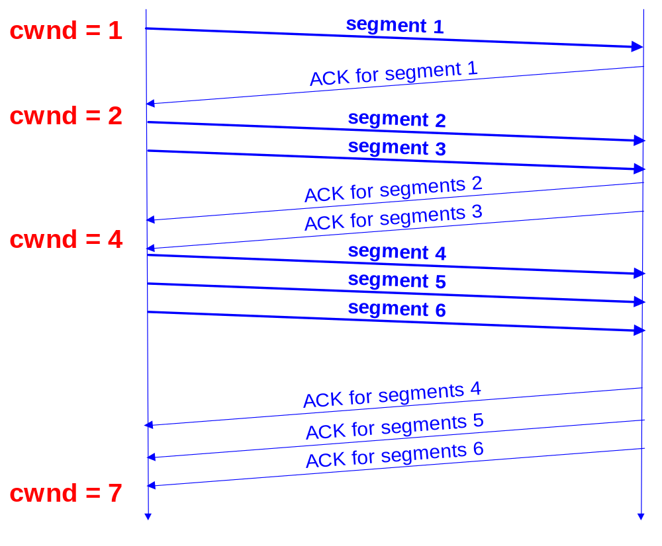
Slow Start Example
The congestion window size grows very rapidly
TCP slows down the increase of cwnd when
cwnd > ssthresh

Slide 36
Congestion Avoidance
Congestion avoidance phase is started if cwnd has reached the slow-start threshold value
If cwnd ≥ ssthresh then each time an ACK is received, increment cwnd as follows:
    cwnd = cwnd + 1/ cwnd
So cwnd is increased by one only if all cwnd segments have been acknowledged.

Slide 37
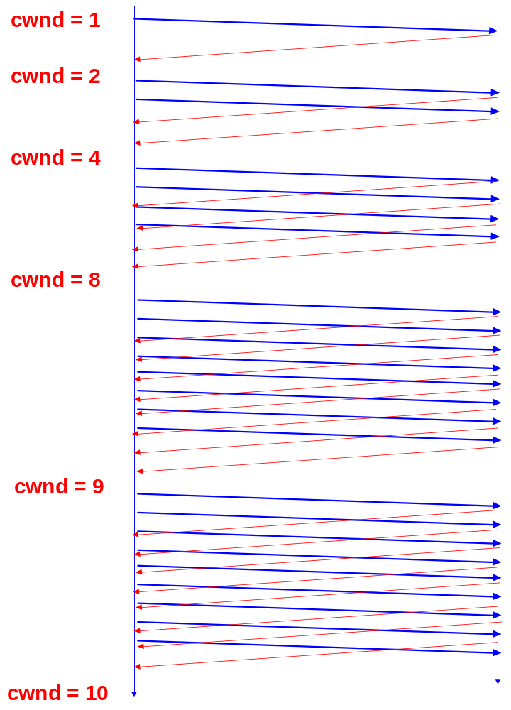
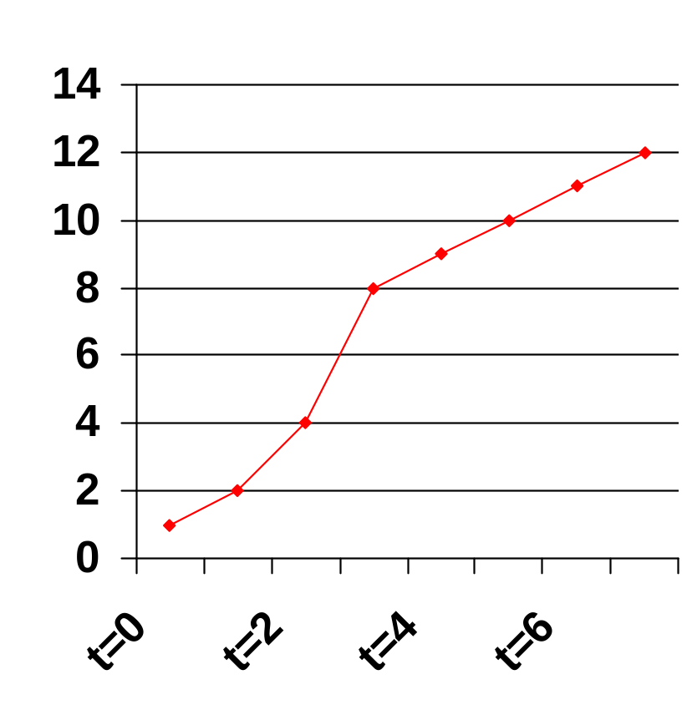
Example
Assume that ssthresh = 8
ssthresh
Cwnd (in segments)
Roundtrip times

Slide 38
Responses to Congestion
TCP assumes there is congestion if it detects a packet loss
A TCP sender can detect lost packets via:
    Timeout of a retransmission timer
    Receipt of a duplicate ACK

Slide 39
Responses to Congestion
TCP interprets a Timeout as a binary congestion signal. When a timeout occurs, the sender performs:
  cwnd is reset to one:
      cwnd = 1
  ssthresh is set to half the current size of the congestion window:
      ssthressh = cwnd / 2
  and slow-start is entered

Slide 40
Summary : Congestion Control
Initially:
cwnd = 1;
ssthresh =
advertised window size;
New Ack received:
if (cwnd < ssthresh)
/* Slow Start*/
cwnd = cwnd + 1;
else
/* Congestion Avoidance */
cwnd = cwnd + 1/cwnd;
Timeout:
/* Multiplicative decrease */
ssthresh = cwnd/2;
cwnd = 1;

Slide 41
Acknowledgments in TCP
Receiver sends ACK to sender
  used for flow control, error control, and congestion control
ACK number sent is next sequence number expected
Delayed ACK: TCP receiver normally delays transmission of an ACK (for about 200ms)
  Why?
ACKs are not delayed when packets are received out of sequence
  Why?

Slide 42
Fast Retransmit
If three or more duplicate ACKs are received in a row, the TCP sender believes that a segment has been lost.
Then TCP performs a retransmission of what seems to be the missing segment, without waiting for a timeout to happen.
Enter slow start:
  ssthresh = cwnd/2
  cwnd = 1

Slide 43
Fast Recovery
Fast recovery avoids slow start after a fast retransmit
Intuition: Duplicate ACKs indicate that data is getting through
After three duplicate ACKs set:
  Retransmit packet that is presumed lost
  ssthresh = cwnd/2
  cwnd = cwnd+3
  Increment cwnd by one for each additional duplicate ACK
When ACK arrives that acknowledges “new data” cwnd=ssthresh and enter congestion avoidance

